Slide 1
BENCHMARK 2 WIREFRAME
Producer Perspective
“Taking a carpool ride home”

Slide 2
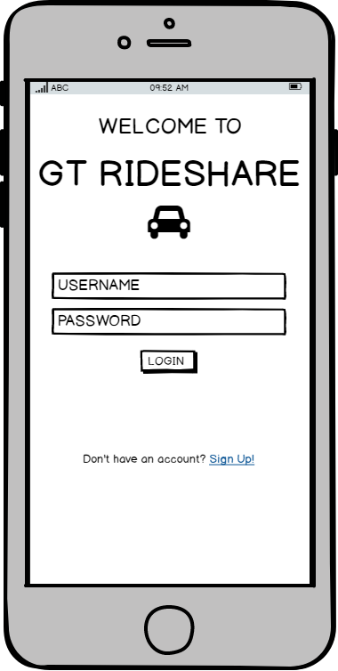
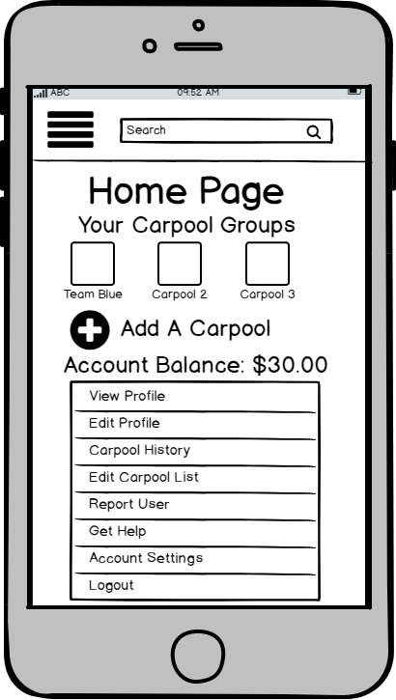

1
2
If the driver/provider already has an account they can just log in.
The driver can click on the carpool group when they want to start a carpool ride or edit any of the information about the carpool group

Slide 3
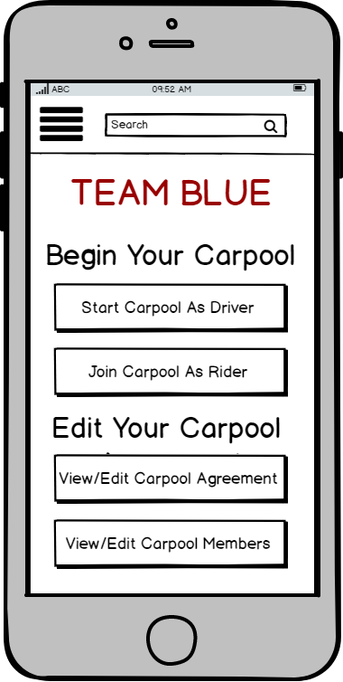
3
When users actually decide to start a ride in the morning or evening they can ensure that they are considered on time by pressing either “start carpool as driver” or “join carpool as rider” Having these options also allows the carpool to rotate who the drivers and riders will be for each carpool ride
When users want to remove themselves or someone else from a carpool group they can do so by pressing “View/Edit Carpool Members”
When Users click on a carpool name from the home page they can choose to edit the rules of the carpool by pressing “View/Edit Carpool Agreement”
If the user decides to be the provider/driver for a carpool, they can chooses to start the carpool as a driver

Slide 4
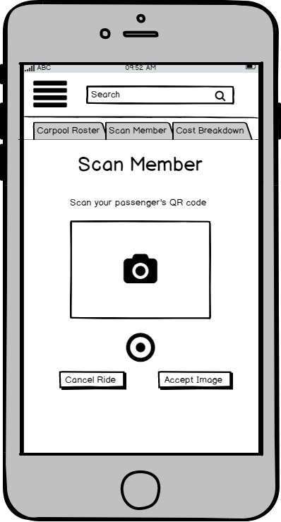
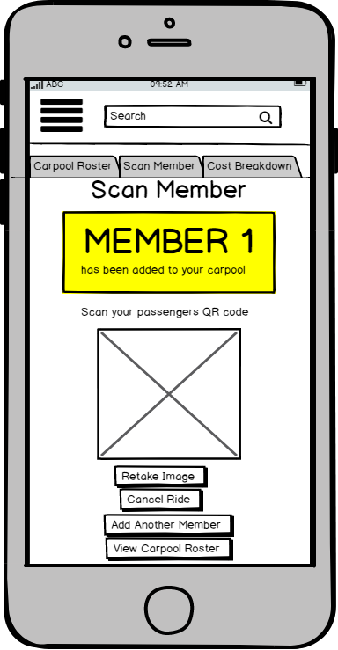
4
5
If the image of the QR code taken in the previous screen is clear and the QR code scanned belongs to an already registered member of the carpool group, the app will indicate that a member has been successfully added to the ride about to take place
Users can always return to this scan member page to add more members to their carpool by clicking on the “scan member” tab at the top of the screen
When the provider/ driver feels that the image of the QR code is clear, they will press “accept image”
The driver/provider can continue to add registered members to the carpool until all of the members have been added by pressing here
When the provider/driver wants to add people to their carpool they just need to take a picture of the QR code that the app will generate on each rider’s phone (The consumer’s screen that is necessary for this process will be shown on Consumer Screen 3)
Once the provider has added all of the carpool members that will be joining this specific ride or if they want to see a list of all of the members that have been added to their carpool, they can click to see the carpool roster

Slide 5
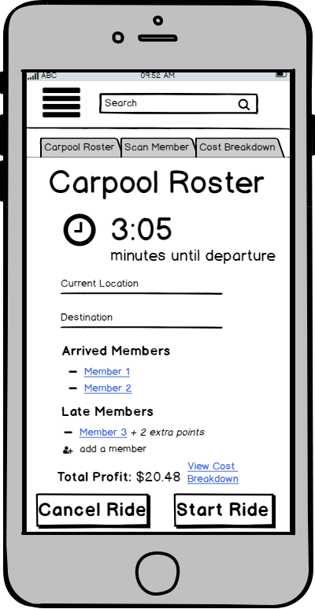
When the time the carpool has agreed to meet has past, a timer will start on the carpool roster that tells the provider how long the group has decided they must wait for late members before they can leave without being penalized.
6
The Carpool Roster can be accessed at any time during the ride process by using the “Carpool Roster” tab
Providers/Drivers earn extra points that can be used for discounts on future rides or cashed out for money when they have to wait for riders. The late members list will show how many extra points the provider is earning by waiting for a late carpool member
The arrived members list contains all of the names of the members of the carpool group whose QR codes have been scanned and successfully added to the carpool ride
The Carpool Roster offers an “emergency ride” feature. If a rider has missed their own carpool group’s ride, the provider can add a carpool member that is not a member of their carpool group to their roster for a one time ride. The provider earns extra points for adding emergency riders.
The late members list has contains all of the members that are registered to be a part of the carpool group, but have not shown up at the agreed upon time
Providers can see how much money they’re earning from the current ride on the carpool roster form
If all of the members for the ride have been added, the provider can choose to start the ride by clicking here
The driver can check to see if their total profit listed on the roster is correct by choosing to view the cost breakdown

Slide 6
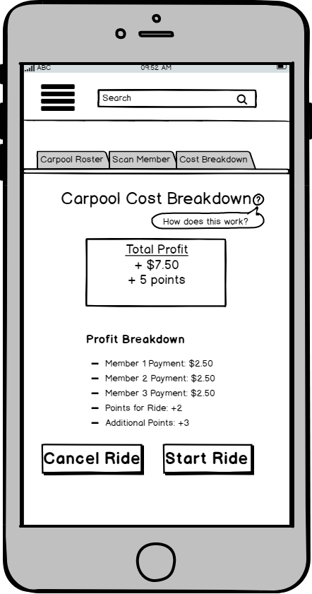
7
The Carpool Cost Breakdown page shows providers the total of how much money they’re earning from the ride and also how many points they’ve earned for the ride
The provider can access the carpool cost breakdown at any time during the ride by pressing the “Cost Breakdown” tab at the top of the screen
Drivers can click the question mark to see how price/ points distribution system the app uses operates
The profit break down shows the users how much money they’re earning from each carpool member
If all of the members for the ride have been added and the profit for the ride is correct, the provider can choose to start the ride by clicking here
Right before the provider is about to drive home, they indicate that the ride will begin by pressing the “Start Ride” button.

Slide 7
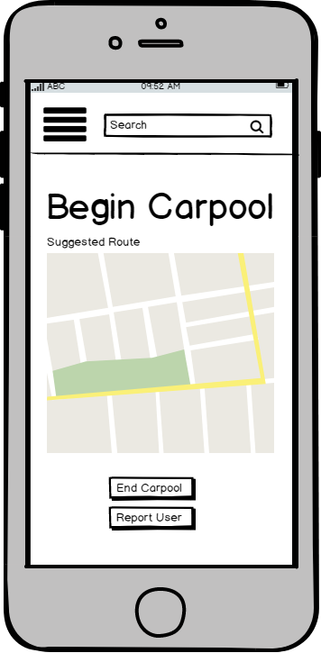
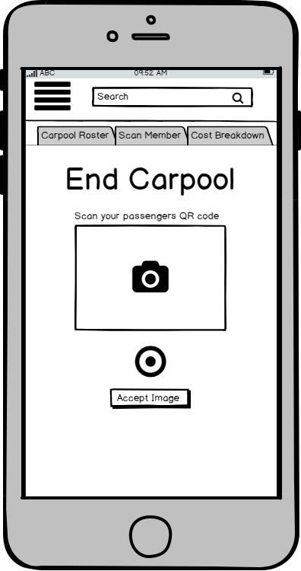
8
9
When the carpool has begun, the app will show the directions for the suggested route home, but users are allowed to take their own routes
In the case that a rider’s conduct is extremely dangerous or inappropriate during the ride, the provider is given the option to immediately report the user
When the provider has arrived to the carpools final destination, they press “End Carpool”
The provider will scan the new QR code that will appear on each consumer’s screen (shown later on Consumer Screen 4) to confirm that each consumer has arrived to the destination

Slide 8
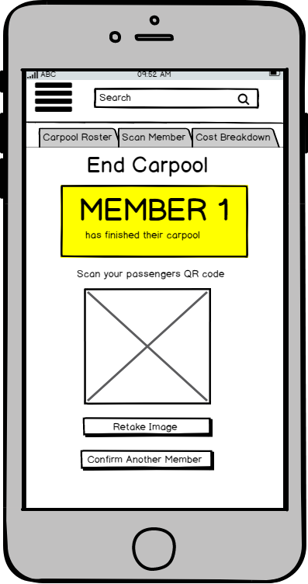
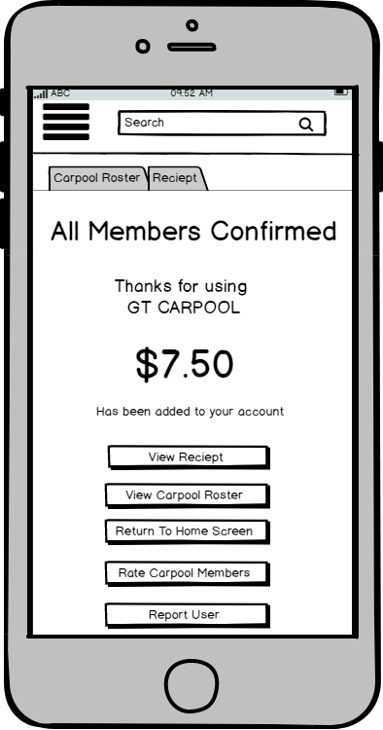
10
11
The app will confirm on the screen when each member of the carpool ride has had their QR code successfully scanned to confirm that their ride has ended
Once each member of the carpool ride has been confirmed to have made it to their location, the app will automatically transition to the next screen and the ride will officially end
Once the ride has ended, the total profit from the ride will be transferred into the provider’s account. And the rider will be given the opportunity to rate their carpool member’s

Slide 9
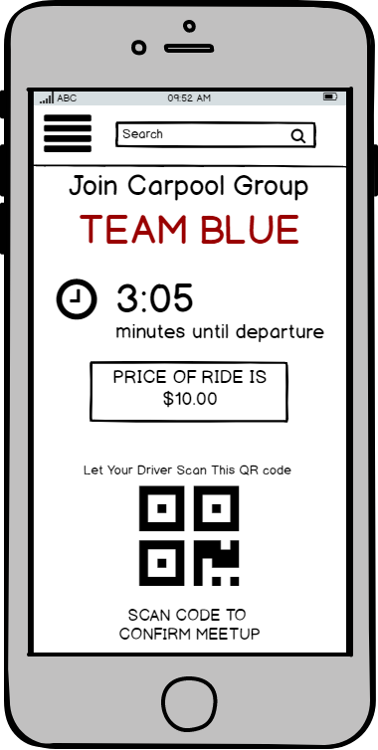
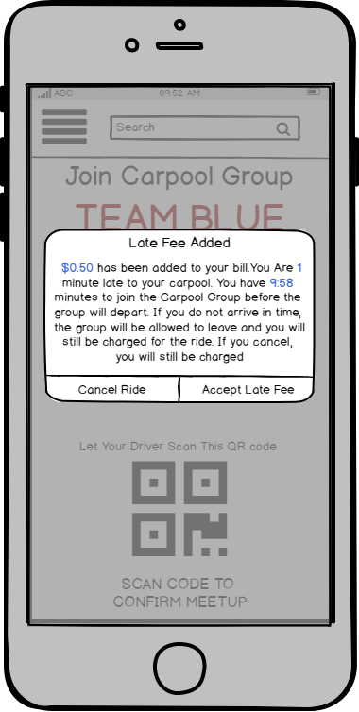
2 SLIDE DETOUR: because the producer’s benchmark involves the consumer’s screens when the consumer is late for their carpool home, the screens of the consumer leading up to joining the carpool group and paying are being shown. Detour Starts after screen 2.
Consumer
Screen 3
Consumer
Screen 4
Consumer
Screen 5
The alert tells consumers how late they are, how long they have to make it to the carpool, and how much their late fee will be
The price of the carpool ride they’re joining is listed on the screen
The consumer is alerted when late. They are given the option to accept the late fees they’ve accrued or cancel their ride
The rider/consumer would choose to join the carpool as a rider when it’s time to ride home
The rider is given a timer for how long they have to get their QR code scanned by the driver (screen 4). before they’re counted as late for the carpool

Slide 10
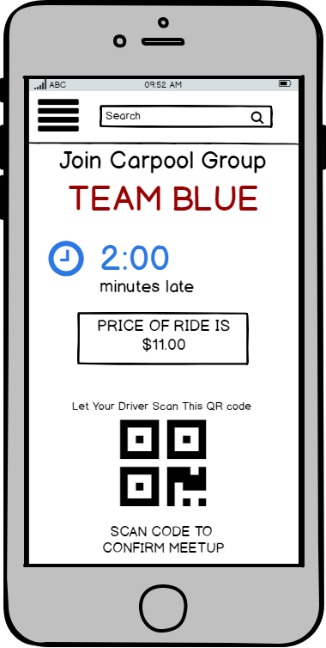
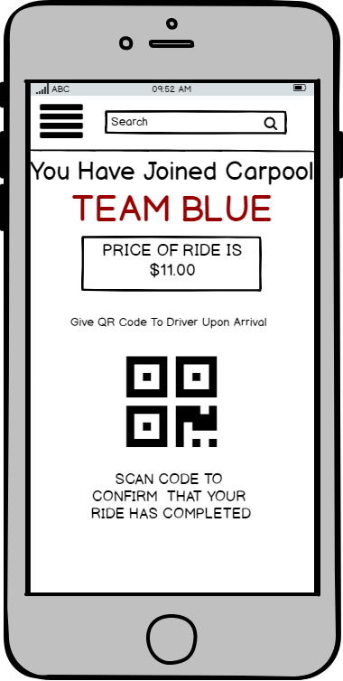
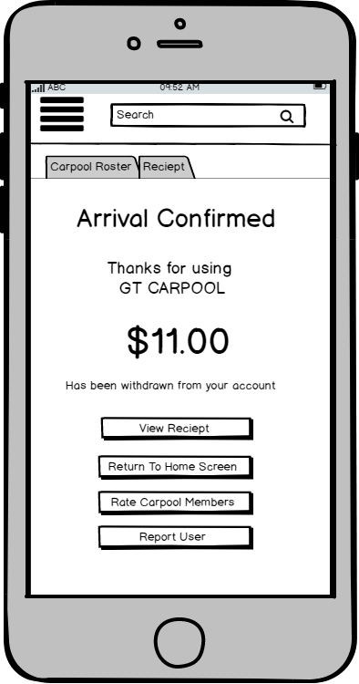
LAST DETOUR SLIDE: Because the provider’s benchmark involves the consumer’s screens when the consumer is late for their carpool home, the screens of the consumer leading up to joining the carpool group and paying are being shown.
Consumer
Screen 4
Consumer
Screen 5
Consumer
Screen 6
Once the consumer has joined the carpool, the QR code will update to the QR code that the Driver must scan to confirm that the ride has ended (screen 9)
Once the provider has scanned the consumer’s QR code (screen 4), the app will show that the consumer has successfully joined the carpool ride and the consumer’s QR code will change
Once the provider has scanned the consumer’s FINAL QR code(Screen 9), the app will show that the ride has completed and the cost of the ride will be withdrawn from the consumer’s account
When the consumer is late, the price of the ride will update as late fees increase. The consumer will also be provided with a timer showing how late they are

Slide 11
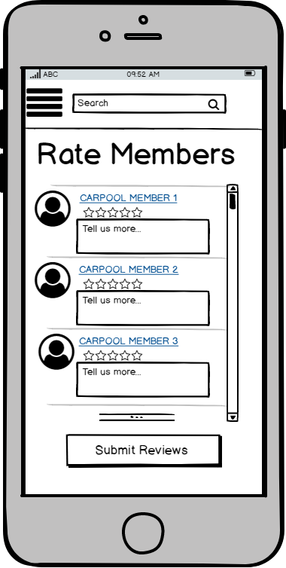
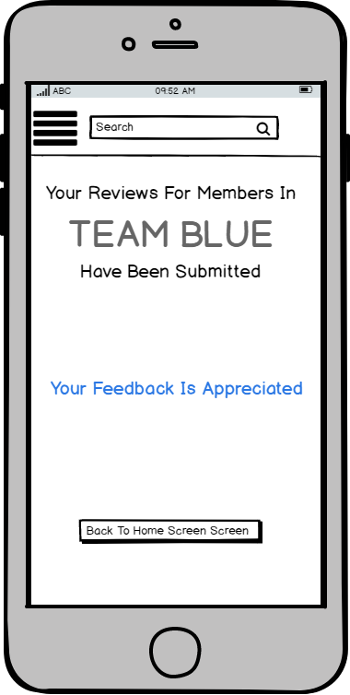
12
13
The Provider can rate their riders using stars and can also leave a written review. The provider can submit their reviews then they are finished
The app confirms that the providers reviews of their carpool members have been submitted and gives providers the option to return to the home screen

Slide 12
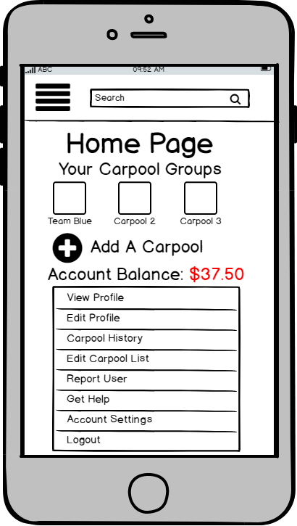
14
Benchmark 2
Completed
The home screen will automatically update the account balance when the ride is over

